Slide 1
Week 6 – GitHub
A way to showcase your projects
Oct. 2, 2026

Slide 2
Topics for Today
GitHub
Next Week

Slide 3
GitHub
Use on your resume

Slide 4

Key Aspects of GitHub
Version Control: A tool that tracks changes made to files, allows people to revert to previous versions
Cloud Hosting: Access repositories from anywhere
Collaboration: Easy for teams to work together
Organization: Projects are organized into repositories

Slide 5

A Great Way to Showcase Your Skills!

Slide 6
Getting Started
How to Use GitHub for Beginners
Learn more through:
  LinkedIn Learning – Free to U of Iowa students
  https://skills.github.com/ - Learn how to use GitHub with short interactive activities
Upload source code and project samples
Add GitHub public link to your resume

Slide 7
GitHub Page Samples
Create a repository
  Kris Arens: https://github.com/kristinearens
Create a Website (These are called GitHub pages)
  Kris’ Sample: https://kristinearens.github.io/testpage-main/

Slide 8
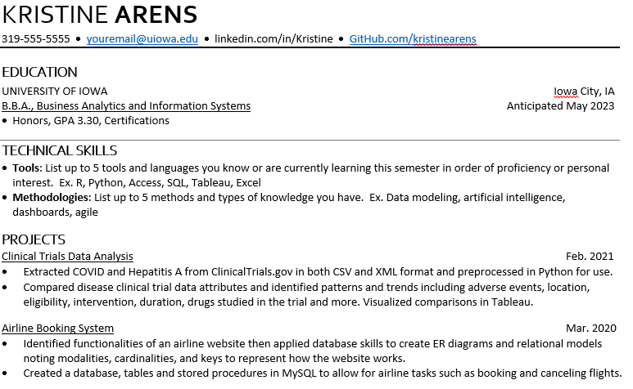
GitHub on Resumes
Showcase your work
Match repository to projects
Provide:
Code examples
Presentations
Data Analysis

Slide 9
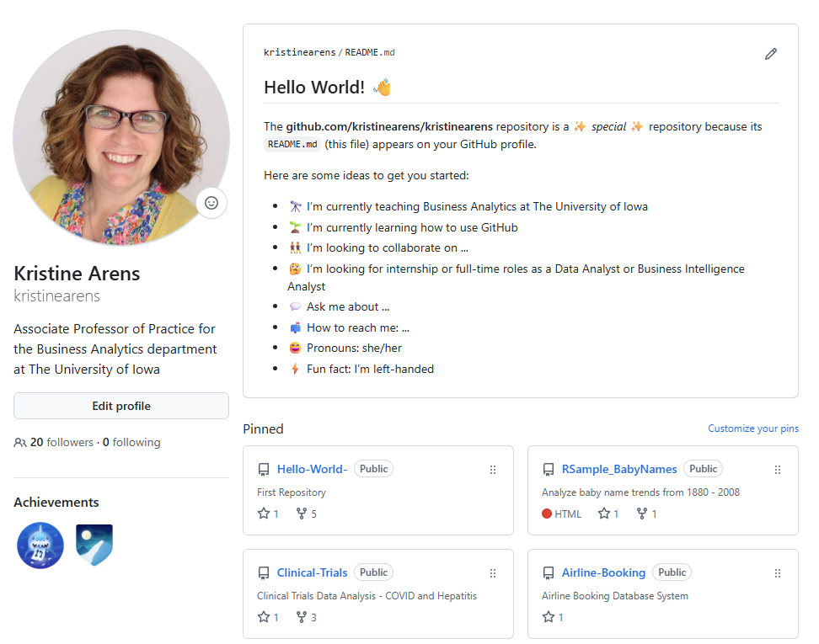
Let’s Take a Look
https://github.com/kristinearens

Slide 10
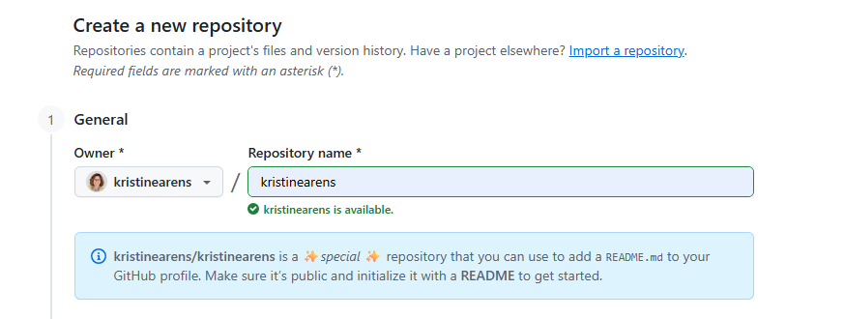
Let’s Add a Little Flare!

Slide 11
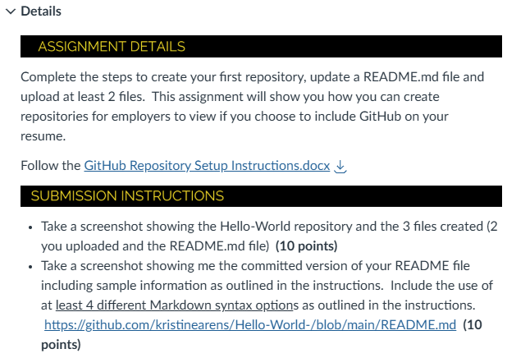
Now Let’s Try Ourselves
Download the GitHub Repository Setup Instructions
Create a Repository
Update the README.md file

Slide 12
Next Week
Getting ready for your career!

Slide 13

Next Week
Tips for Success
Negotiating Your Offer

Slide 14

GitHub Assignment
This is a required assignment!
You must complete this assignment to pass this class.

